Slide 1
Sutton and Merton CBS
Specialist Older People Mental Health Liaison/input to Residential and Nursing Homes in Sutton and Merton
Dr Victoria Hill
Clinical Lead

Slide 2
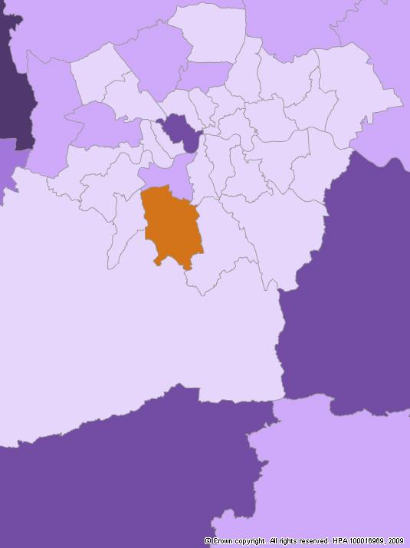
Our Population
Population 65+ = 58.6k across Sutton and Merton
Approx. 3900 people with dementia
Approx. 1/3 in care homes (1300)
For 65+ & dementia;
34 OP care homes in Sutton (29 Dementia)
21 OP care homes in Merton (15 dementia)
CBS has regular referrals from 39 of those 55 care homes across the two boroughs.

Slide 3
Service Specifics
Service was formed in 2008 in Sutton and expanded to Merton in 2010.
Based at Cheam Resource Centre in North Cheam
Working Hours: Monday – Friday 9-5.
GP referrals accepted via ErS or email
SuttonOlderPeopleServices@swlstg.nhs.uk
MertonOPAdminTeam@swlstg.nhs.uk
New referrals usually seen within 1-3 weeks (28 days max) depending on urgency.

Slide 4
Referrals
GP referrals – via the CMHT’s or directly to CBS (ErS/Email)
Direct referrals from the CCG Continuing Health Care Teams.
Referrals accepted directly from care homes on a case by case basis with prior GP approval and physical screening.
Internal referrals from CMHT/ liaison psychiatry/Inpatient Wards
Social services referrals via GP.
Care Home Support Team – direct referrals accepted

Slide 5
Eligibility Criteria - inclusion
Residents of care homes within the boroughs of Sutton or Merton who present with behavioural and psychological symptoms of dementia (no age criteria)
Residents in specialist CB placements, funded by the CCG – case by case decision. (some homes just outside borough)
Residents in care homes (Sutton and Merton) who are 75+ and without dementia but presenting with mental health/behavioural difficulties which staff are finding challenging to manage (case by case decision)

Slide 6
Eligibility Criteria - exclusion
Residents of care homes outside of the boroughs of Sutton or Merton.
Residents with traumatic brain injury (eg: head injury, Infections) without progressive neurodegeneration.
Residents with suspected acute confusional state.
Clients with dementia and CB who are currently living in their own homes. (CBS will provide consultation to the CMHT on a case by case basis)
Residents under the age of 75 with enduring functional mental health problems but with no (or suspected) dementia (as per OPCMHT eligibility criteria)

Slide 7
Who are we?
Core team establishment is currently 3.5 staff
0.5 wte Psychology Lead: Dr Victoria Hill
2 wte x CPNs: Amanda Fox, Elizabeth Schofield
1 wte x Assistant Psychologist: Jedrah Owusu-Mensah
Psychiatry input provided by the Sutton and Merton Older People CMHTs:
Dr Stinson, Dr Oyegunle (Sutton);
Dr Shah, Dr Al-Daghistani (Merton).

Slide 8
Service Model/Principles
Holistic assessments and interventions to residents in care homes
Behaviours assessed as a form of communication or an unmet need.
Assist staff to understand behaviours within a biopsychosocial/ personal centred framework.
Reduce the use of medication as first line treatment where possible (its not always possible) – increase the use of psychosocial approaches/ interventions.
Improve overall staff skills and therefore quality of care including least restrictive care interventions
Reduce NHS inpatient admissions and/or the need to move care homes.

Slide 9
Holistic Assessment/Formulation

Slide 10
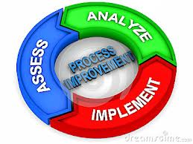
Clinical Process – Newcastle Model
Wk 1 - 2: Assessment with staff, patient, family and others as appropriate
Wk 2 - 3: Observations and gathering further info via behavioural charts
Wk 4 - 5: Information sharing session with staff and develop collaborative care plan
Wk 6: Write up care plan and deliver to care home, family, GP
Wk 7-11: Follow up and review and revise formulation and care plan if necessary
Wk 12: Discharge

