Slide 1
Infection Prevention and Control Nursing, Residential & LD Care Homes 22nd June 2021
Helen Thurlow– IPC Project Lead

Slide 2
Local Dashboard week 10th – 16th June 2021 cases per 100,000
Croydon 58 down 13%
Kingston 57 down 5%
Merton 70 up 99%
Richmond 65 up 47%
Sutton 59 up 12%
Wandsworth 95 up 9%
SWL 73 up 13%
London 67 up 20%

Slide 3
Care Homes Residents Can Stay Overnight as Restrictions Ease Published 17 June 2021
Care home residents will be able to spend more time with family and friends, including overnight stays as part of an easing of visiting restrictions announced last week
Latest guidance on this was published 17.6.21
Decisions about an individual resident’s visits outside of a care home should be taken with the resident’s assessed needs and circumstances considered

Slide 4
Risk assessments for visits
The care home should balance the benefits of visits out of the care home against a consideration of the risks to others in the home, where necessary.
Individual risk assessments should take into account:
the vaccination status of residents, visitors and staff
levels of infection in the community
variants of concern in the community
where the resident is going on a visit and what activities they will take part in while on the visit
the mode of transport residents intend to use

Slide 5
Admitting residents from the community (Press release)
From 21st June, people admitted to a care home from the community will no longer have to self-isolate for 14 days on arrival, so residents will have a less disruptive introduction to their new home
To ensure this happens safely, residents will undergo an enhanced testing regime - a PCR test before admission, a PCR test on the day of admission and a further PCR test 7 days later
Care home residents would still need to isolate for 14 days following:
a visit out that would be deemed high risk through a risk assessment
After an overnight stay at hospital
If admitted from hospital or other care home

Slide 6
Essential care givers
The government has also strengthened the role of the ‘essential care giver’, which means every resident should be able to nominate a friend or family member to provide extra care on their visits. Essential care givers can continue to visit during outbreaks
The essential care giver role is intended to provide additional support from someone with a unique personal relationship with the resident
They have access to the same personal protective equipment (PPE) and testing supply as care home workers and should be allowed to continue to visit during periods of isolation or where there is an outbreak

Slide 7
Proposal to make vaccination condition of deployment
The Department of Health and Social Care released a press statement on 16th June 2021 saying ‘People working in CQC-registered care homes will need to be fully COVID-19 vaccinated with both doses’
The new legislation means from October – subject to Parliamentary approval and a subsequent 16-week grace period – anyone working in a CQC-registered care home in England for residents requiring nursing or personal care must have 2 doses of a COVID-19 vaccine unless they have a medical exemption
It will apply to all workers employed directly by the care home or care home provider (on a full-time or part-time basis), those employed by an agency and deployed by the care home, and volunteers deployed in the care home
Those coming into care homes to do other work, e.g. healthcare workers, tradespeople, hairdressers and beauticians, and CQC inspectors will also have to follow the new regulations, unless they have a medical exemption
It will only apply to people who need to enter the building

Slide 8
Proposal to make vaccination condition of deployment
The responses to the consultation made a case for extending this policy beyond care homes to other settings where people vulnerable to COVID-19 receive care, such as domiciliary care and wider healthcare settings
The government continue to work with stakeholders to identify further actions at a local, regional and national level to increase vaccine uptake
As part of this, targeted support to older adult care homes where vaccine uptake is low, such as in London, is underway. As of 4 April 2021, vaccine uptake among eligible workers in older adult care homes in London is 67.8%, compared to 82.4% in the South West. All of this is supplemented by work locally, by employers, local authorities, public health teams and others
The government will launch a further public consultation on whether or not to make COVID-19 and flu vaccination a condition of deployment in health and care settings

Slide 9
IPC news
3rd Care Home Champion meeting
28th June 2-3pm
Hand hygiene audit
Prevention of dehydration and implications on preventable infections
Usually last Monday of month
Book (more details) through Helen Thurlow IPC project lead helen.thurlow@swlondon.nhs.uk

Slide 10
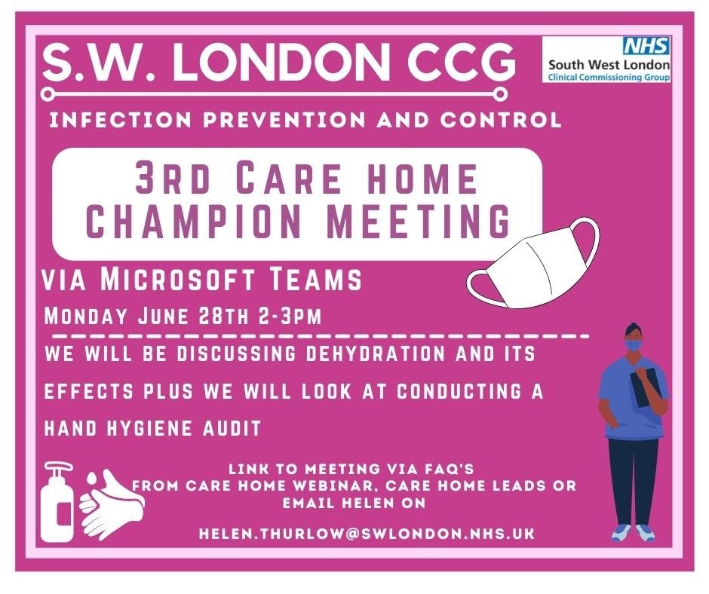
We look forward to seeing you

