Slide 1
COVID-19: how to work safely in care homes Care Home Sector Webinar Public Health England and Department of Health and Social Care 18th May 2021

Slide 2
 | AGENDA
10.30 | Welcome & Aim of Webinar Deborah Sturdy, Chief Nurse for Adult Social Care in England
10.40 | What has changed in the May version of the How to Work Safely in Care Homes guidance Dr Catherine Heffernan, Consultant in Public Health, PHAGE, Public Health England
10.55 | Applying the guidance to different scenarios Susie Singleton, Consultant Nurse Health Protection & IPC Centre’s & Regions National Lead Alison Phillis, Lead Infection Prevention and Control Nurse Lesley Smith, Infection Prevention and Control Lead, HCAI & AMR Division Liz Stokle, Consultant Nurse Health Protection & Infection Prevention and Control Della Gilby, CEO, D & L Support Ltd and Co-Chair of Gloucestershire Care Providers Association
11.30 | Panel Q&A

Slide 3
Welcome and Aim
The aim of today’s webinar is to support care home managers and other guidance users to implement the revised COVID-19 ‘How to work safely in care homes’ guidance.
This guidance was published on Monday 17th May 2021.
It updates the ‘How to work safely in care homes’ guidance published on 6th April 2021 following feedback from guidance users across the adult social care sector.
It was also updated in line with current evidence including surveillance and epidemiology of COVID-19.
Deborah Sturdy, Chief Nurse for Adult Social Care in England

Slide 4
 | AGENDA
10.30 | Welcome & Aim of Webinar Deborah Sturdy, Chief Nurse for Adult Social Care in England
10.40 | What has changed in the May version of the How to Work Safely in Care Homes guidance Dr Catherine Heffernan, Consultant in Public Health, PHAGE, Public Health England
10.55 | Applying the guidance to different scenarios Susie Singleton, Consultant Nurse Health Protection & IPC Centre’s & Regions National Lead Alison Phillis, Lead Infection Prevention and Control Nurse Lesley Smith, Infection Prevention and Control Lead, HCAI & AMR Division Liz Stokle, Consultant Nurse Health Protection & Infection Prevention and Control Della Gilby, CEO, D & L Support Ltd and Co-Chair of Gloucestershire Care Providers Association
11.30 | Panel Q&A

Slide 5
What has changed in the May version of the ‘How to Work Safely in Care Homes’ guidance
Dr Catherine Heffernan, Consultant in Public Health, Advice & Guidance, PHAGE, PHE

Slide 6
Why the change?
On April 6th 2021, the How to Work Safely in Care Homes guidance was updated and published.
The guidance has a different overall layout/look than the previous version.
Three new content changes:
If a resident has respiratory symptoms compatible with recent COVID-19 infection or has tested positive for COVID-19 it is recommended that eye protection (visor or goggles) is worn (along with a Type IIR mask, which is already required).

Slide 7
Why the change?
The eye protection and facemask should be removed and disposed of after completing personal care. If the eye protection is not labelled as single use only, it needs to be decontaminated before reuse.
Sessional use of masks is no longer recommended when giving personal care, in the updated guidance. At the end of each client contact when giving personal care, the facemask should be disposed of and fresh PPE, including a new facemask, will need to be donned before entering the next client’s room.

Slide 8
Why the change?
There was confusion in interpreting the April 6th guidance (later amended on 10th April but reinstated at the request of stakeholders on the 16th).
PHE with the stakeholders reviewed the guidance to provide clarification.
This included revisiting the evidence base and updating the guidance.

Slide 9
What has changed?
Clarifies the meaning of sessional use and the difference between source control and personal protective equipment (PPE):
In this guidance, a session refers to a period of time where a care worker is undertaking a duty which is not delivering direct personal care to a COVID-19 positive resident or a resident with respiratory symptoms in a specific setting or environment. The session ends when the care worker finishes that task and leaves that care setting/environment or takes a break. Sessional use is also when the care worker is providing continuous care for a cohort of residents who are not COVID-19 positive or have respiratory symptoms.

Slide 10
What has changed?
Clarifies the safe use of face masks and when to use them, focusing on the use of:
The Type I or II face mask which is worn to protect others from you (source control).
The Type IIR face mask which is used as PPE. Type IIR face masks help to protect you, the wearer, from exposure to COVID-19 but also act as source control, protecting others from you.
Clarifies when to change a Type IIR face mask (being worn as PPE) following direct personal care.

Slide 11
What has changed?
Clarifies that sessional use of PPE (i.e. not changing a Type IIR face mask) is not recommended when providing direct personal care to COVID-19 positive residents or residents that may have symptoms of COVID-19.
Clarifies that you can have sessional use of a face mask (Type I or II) when carrying out domestic duties or other activities more than 2 metres from residents.
New advice on what to do when within 2 metres of a resident or anyone else within your working environment
An updated section on ‘what to do with waste including disposing of PPE’ safely.

Slide 12
To help with risk assessment
This guidance covers what PPE to wear in three main scenarios:
Providing direct personal care (Tables 1-3)
Other contact within 2 metres of anyone else (Table 4)
Carrying out domestic duties or other activities (Table 5)
The recommended items of PPE are described for each of these scenarios.
There are also sections on putting on and removing PPE, handling waste (including PPE), cleaning eye protection between uses and aerosol generating procedures (AGP).

Slide 13
 | AGENDA
10.30 | Welcome & Aim of Webinar Deborah Sturdy, Chief Nurse for Adult Social Care in England
10.40 | What has changed in the May version of the How to Work Safely in Care Homes guidance Dr Catherine Heffernan, Consultant in Public Health, PHAGE, Public Health England
10.55 | Applying the guidance to different scenarios Susie Singleton, Consultant Nurse Health Protection & IPC Centre’s & Regions National Lead Alison Phillis, Lead Infection Prevention and Control Nurse Lesley Smith, Infection Prevention and Control Lead, HCAI & AMR Division Liz Stokle, Consultant Nurse Health Protection & Infection Prevention and Control Della Gilby, CEO, D & L Support Ltd and Co-Chair of Gloucestershire Care Providers Association
11.30 | Panel Q&A

Slide 14
Applying the guidance to different scenarios
Dr Catherine Heffernan, Consultant in Public Health, Advice & Guidance, PHAGE, PHE

Slide 15
What to do if….
Doing the tea round when residents are in the lounge
Following their lunch break, the carer cleans their hands, dons a type II mask and attends to the tea round in the communal lounge.
The carer wears their mask continuously for the duration of handing out the drinks. She then dons a type IIR masks, visor, plastic apron and gloves to support Mr J with his drinking as he has some difficulty swallowing and is prone to choking.
Lesley Smith, Infection Prevention and Control Lead, PHE
Lesley Smith, Infection Prevention and Control Lead, PHE

Slide 16
What to do if….
Doing the tea round when residents are in the lounge
Although he often uses a serviette he suddenly coughs violently and tea and spittle splash the carer’s visor and plastic apron.
She settles Mr J and leaves the lounge to remove her PPE in the sluice.
Lesley Smith, Infection Prevention and Control Lead, PHE

Slide 17
What to do if….
Doing the tea round when residents are in the lounge
She removes the gloves and plastic apron placing it in the domestic waste marked for double bagging, dons a new plastic apron and gloves to clean her reusable visor according to the manufacturer’s instructions, she removes her PPE in accordance with the donning and doffing guidance, and dons a fresh mask after the final hand wash.
Lesley Smith, Infection Prevention and Control Lead, PHE
Lesley Smith, Infection Prevention and Control Lead, PHE

Slide 18
What to do if….
Doing the clean linen round (table 4)
Type I or II Surgical mask or Type IIR | Yes
Disposable gloves (vinyl, latex or nitrile) | No
Disposable plastic apron | No
Eye protection (unless there is a risk of contact with body fluids, risk of contact from residents who may be coughing, sneezing or spitting or a risk of splashing from cleaning products) | No
Alison Phillis, Infection Prevention and Control Nurse, PHE

Slide 19
What to do if…
Doing the clean linen round
Before task:
Clean hands on entry to work
Don a type II face mask
End of task:
Clean hands
Continue to wear facemask until coffee break/higher specification task as no contamination
To change mask:
Remove using ties and place into a domestic waste bin
Clean hands
Replace new type II facemask before contact with anyone else (avoid social contact within 2m)

Slide 20
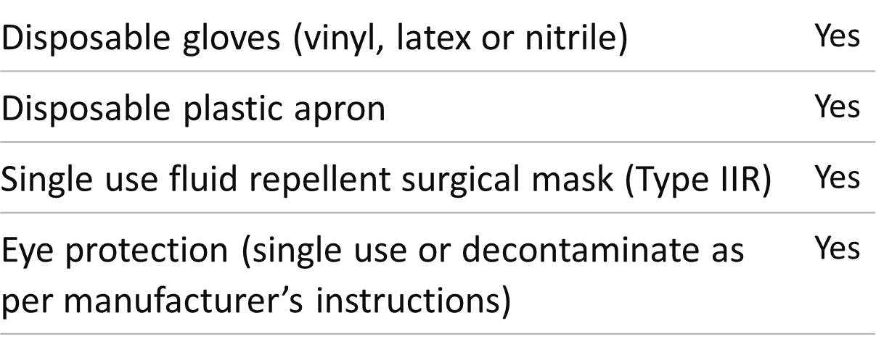
What to do if…
Cleaning a COVID positive resident room (table 1)
Alison Phillis, Infection Prevention and Control Nurse, PHE

Slide 21
What to do if… Cleaning a COVID positive resident room
Before task:
Clean hands
Don a type IIR face mask, collect equipment (single use as much as possible) bin liners (offensive/infectious*), spare gloves and apron
Don apron, eye protection, gloves
Prepare as much as possible outside of the room; only take essential equipment in
End of task:
Clean as much reusable equipment as possible and place by the door. Place used cloths, disposable equipment, waste into the waste bin liner; remove gloves, apron within the room and dispose of into the infectious/offensive* bin liner and seal
Clean hands and don a clean apron and gloves for transporting reusable equipment and sealed waste to the sluice/utility
Once there, place waste into an outer bag/bin* labelled for 72hrs storage. Disinfect reusable equipment. Remove gloves and clean hands. Remove apron by the ties, place in the labelled waste bin, remove and if reusable, clean eye protection, remove face mask by the ties and dispose. Clean hands
Before next task/contact with anyone else:
Don a clean facemask (type I,II or IIR depending on the next task) before contact with anyone else
*NB Settings: nursing care – offensive/infectious; non nursing care – double bag in domestic waste stream

Slide 22
What to do if…
PPE recommendations when within 2 metres of a resident and carrying out direct personal care where there is a risk of contact with respiratory symptoms or body fluids (table 2)
Liz Stokle, Consultant Nurse Health Protection & IPC, PHE
Disposable gloves (vinyl, latex or nitrile) | Yes
Disposable plastic apron | Yes
Single use fluid-repellent surgical mask (Type IIR) | Yes
Eye protection (single use or decontaminate as per manufacturer’s instructions) | Yes

Slide 23
What to do if…
Medication round, nursing home, symptomatic resident
Restrict number of carers (as best possible).
Timing of care – order of medication round (as best possible).
Safe storage and management of PPE.
Dealing with contamination of self and equipment.
Know your waste stream: Domestic / Offensive / Infectious
Scenario – Mr H developed a cough
Liz Stokle, Consultant Nurse Health Protection & IPC, PHE

Slide 24
What to do if….
Confirmed COVID resident / suspect COVID resident/ resident with respiratory symptoms in single room
Before entering room:
Hand hygiene using alcohol gel or soap and water.
Put on all PPE. If already wearing fluid repellent surgical mask (FRSM) it can stay on.
If wearing type I or type II mask change into a FRSM (hands must be cleaned after removing first mask).
Put on visor, apron followed by gloves.
Liz Stokle, Consultant Nurse Health Protection & IPC, PHE

Slide 25
What to do if….
Confirmed COVID resident / suspect COVID resident / resident with respiratory symptoms in single room
Having entered room:
Deliver personal care (avoid touching your face & eyes with gloved hands)
Gloves should be changed as needed between care interventions i.e. if dealing with faecal matter, urine and wounds
Alcohol gel / soap and water should not be applied to gloves.
Liz Stokle, Consultant Nurse Health Protection & IPC, PHE

Slide 26
What to do if….
Confirmed COVID resident / suspect COVID resident / resident with respiratory symptoms in single room
Before leaving room:
Take off gloves and apron and dispose of into the infectious / offensive waste bin in the room - wash hands with soap & water or use alcohol gel between each step.
Leave room (still wearing mask and visor).
Liz Stokle, Consultant Nurse Health Protection & IPC, PHE

Slide 27
What to do if….
Confirmed COVID resident / suspect COVID resident / resident with respiratory symptoms in single room
At earliest opportunity remove visor – dispose of (see detail on waste) or clean & store appropriately (according to manufacturer’s guidance).
Wash hands with soap & water or use alcohol gel.
Carefully take off mask by loops/ties - avoid touching outside of the mask
Liz Stokle, Consultant Nurse Health Protection & IPC, PHE

Slide 28
What to do if….
Confirmed COVID resident / suspect COVID resident / resident with respiratory symptoms in single room
Dispose of into infectious (orange bags) / offensive (tiger bags) or domestic waste (black bags) as national guidance
Wash hands with soap & water or use alcohol gel
Put on clean mask (Type I, II or FRSM) depending on the next task that you are about to undertake.
Liz Stokle, Consultant Nurse Health Protection & IPC, PHE

Slide 29
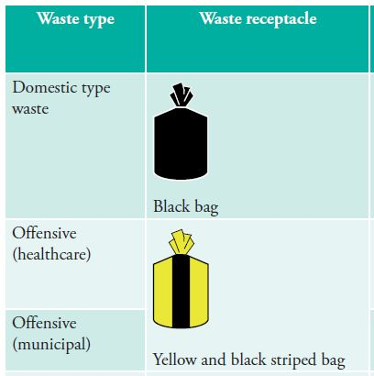
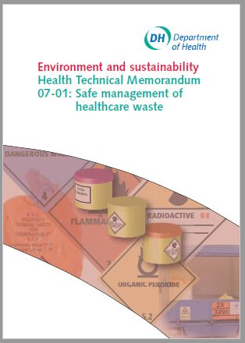
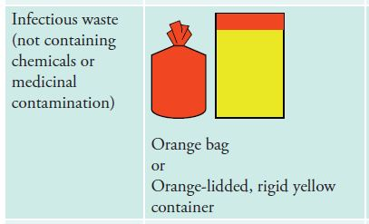
Safe management of waste
Health Technical Memorandum (HTM) 07-01

Slide 30
What to do if…
Assisting with an activity
The carer and activities co-ordinator are assisting with craft activities with 3 residents around a table. They are making Christmas card involving cutting and gluing.
Before the activity the carer cleans their hands and put of a Type II mask.
All the residents are well and there is no likely contact with blood or body fluids during the activity.
Lesley Smith, Infection Prevention and Control Lead, PHE
Lesley Smith, Infection Prevention and Control Lead, PHE

Slide 31
What to do if…
Assisting with an activity
The carer offers assistance to each of the residents as needed and carries out hand hygiene after each contact (ensure alcohol gel is close to hand).
Mrs B cuts her finger with the scissors and it is bleeding quite a lot.
The carer dons an apron and gloves to deal with the injury, applies a dressing and settles Mrs B.
Lesley Smith, Infection Prevention and Control Lead, PHE

Slide 32
What to do if…
Assisting with an activity
The carer goes to the designated area for doffing to remove their gloves and apron. Disposes of them in the offensive waste stream. The mask can remain on as there is no contamination to the outside of the mask.
The carer washes their hands and return to assist with the activity.
Lesley Smith, Infection Prevention and Control Lead, PHE
Lesley Smith, Infection Prevention and Control Lead, PHE

Slide 33
What to do if…
Not all bed-based care is older persons specific
Della Gilby, Chair of Gloucestershire Care Providers and CEO/ Registered Manager of D&L Support Limited

Slide 34
ENVIRONMENT
Residential care for individuals with Autism or a learning disability is usually provided in a family-sized property
Size impacts upon the ability to implement:
social distancing
best practice donning and doffing
managing the expectations of the individuals whom we support
GUIDANCE
Ambiguity
Quantity
Timing
Conflicting/ variations
TRAINING
Trip to the fire station
Managers Network
Innovative adaptation
LESSONS LEARNED
Appreciation of sector differences
More accessible information
PPE Portal and LRF availability
Training resources more useful

Slide 35
What to do if…
Residents having a boogie sitting down or standing up
Sitting better than standing - 2 metres between residents.
If dancing with residents - apron and mask would need to be worn, visor if singing or resident coughs.
Apron changed and hands washed or gelled between residents if dancing with each resident.
Liz Stokle, Consultant Nurse Health Protection & IPC, PHE
Liz Stokle, Consultant Nurse Health Protection & IPC, PHE

Slide 36
What to do if…
Residents having a boogie sitting down or standing up
if singing is likely:
Known risk from singing but therapeutic element recognised
Residents spaced 2 metres apart in all directions but
Preferable that singing takes place only in larger well-ventilated spaces, or outdoors.
Microphone - handing a microphone around is not recommended.
Liz Stokle, Consultant Nurse Health Protection & IPC, PHE
Liz Stokle, Consultant Nurse Health Protection & IPC, PHE

Slide 37
What to do if…
Residents having a boogie sitting down or standing up
if singing is likely:
Hygiene afterwards
Residents should be supported in washing their hands thoroughly.
If indoors, all surfaces should be cleaned and disinfected afterwards.
Liz Stokle, Consultant Nurse Health Protection & IPC, PHE
Liz Stokle, Consultant Nurse Health Protection & IPC, PHE

Slide 38
 | AGENDA
10.30 | Welcome & Aim of Webinar Deborah Sturdy, Chief Nurse for Adult Social Care in England
10.40 | What has changed in the May version of the How to Work Safely in Care Homes guidance Dr Catherine Heffernan, Consultant in Public Health, PHAGE, Public Health England
10.55 | Applying the guidance to different scenarios Susie Singleton, Consultant Nurse Health Protection & IPC Centre’s & Regions National Lead Alison Phillis, Lead Infection Prevention and Control Nurse Lesley Smith, Infection Prevention and Control Lead, HCAI & AMR Division Liz Stokle, Consultant Nurse Health Protection & Infection Prevention and Control Della Gilby, CEO, D & L Support Ltd and Co-Chair of Gloucestershire Care Providers Association
11.30 | Panel Q&A

Slide 39
Panel Questions and Answers
Questions invited from the audience

