Slide 1
Proxy Ordering

Slide 2
What is Proxy Ordering
Proxy access was developed to allow someone other than the patient to access and manage parts of their GP online services account on their behalf. The staff member is given their own online access account (rather than using the patient’s login details).
GP practices can set up proxy access to see things such as up to date and accurate information on people they care for including; brief medical over, diagnoses, allergies/adverse reactions and other clinical data

Slide 3
What is Proxy Ordering
When staff in the care home are given proxy access by the GP practice, they can:
Order repeat prescriptions
Include a note to the GP.
Adding a note to the GP practice may be particularly useful when an item is marked on the GP system as needing to be reviewed with the patient.

Slide 4
What is Proxy Ordering
Audit Trails
An audit trail is kept in the GP system when a proxy accesses a patient’s record. For repeat prescriptions it records:
who accessed the record and when
what medication was ordered
who authorised or rejected the request and when.
This would assist home with CQC’s Regulation 12 around Safe Handling of Medication and also assist with safeguarding and other investigations.

Slide 5
What is Proxy Ordering
Who needs to be involved?
The following people need to be involved:
Care home lead is the person who will manage talking to residents and their representatives, brief other care home staff about the changes and what they will need to do, and work with the GP practice
GP practice lead to work with the care home project lead, set up proxy access accounts for the care home staff and link these to each named residents’ GP record
Care home staff who will order medication using the agreed process, understand their responsibility for security and confidentiality and be up to date with information governance training

Slide 6
What is Proxy Ordering
Who needs to be involved?
GPs who will use existing process to authorise or reject medication requests
Pharmacist who will use existing processes to dispense medication
Residents (or their representatives) known to the GP practice who will give or refuse permission for care home staff to have proxy access to their GP record
Resident’s representative(s) where the resident cannot understand and make informed decisions for themselves

Slide 7
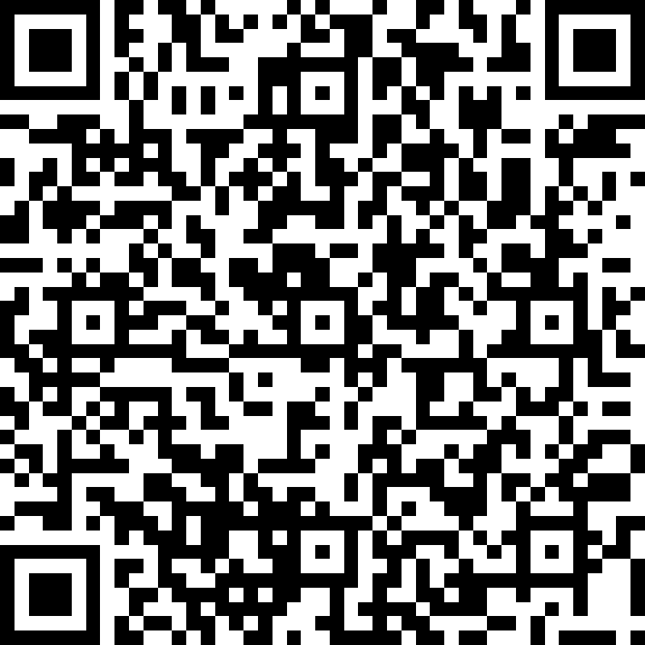
SWL Proxy Ordering Project
Proxy Ordering Project
From the 1st February – 30th April 2021, South West London are commencing an project to implement proxy ordering in 98 of its Care Homes.
We will be running an (EOI) expression of interest process to find 98 homes to commence this system over the next 3 months (Expression of Interest form below & QR Code – to be submitted by 9th February 2021)

Slide 8
EOI Process & Shortlisting to identify 98 care homes
Proxy Ordering Timeline
1
2
Induction Meetings
4
Implementation
Information governance and permissions
3
5
Ongoing Support from the Proxy Ordering Support Team

Slide 9
SWL Proxy Ordering Project
Benefits of Proxy Ordering
Fewer risks and issues associated with ordering, issuing, collecting, and dispensing repeat medications
Fewer errors and queries (e.g. missing items, what has been ordered/collected from pharmacy)
Improved clinical safety
Easier and faster access, as care home staff can order at any time of the day or night
An improved, easy to access audit trail
Improved data security due to care home staff have their own username and password
Better communications and working relationships between all
Supporting evidence of CQC standards for care homes, particularly around effective, responsive & well-led categories

Slide 10
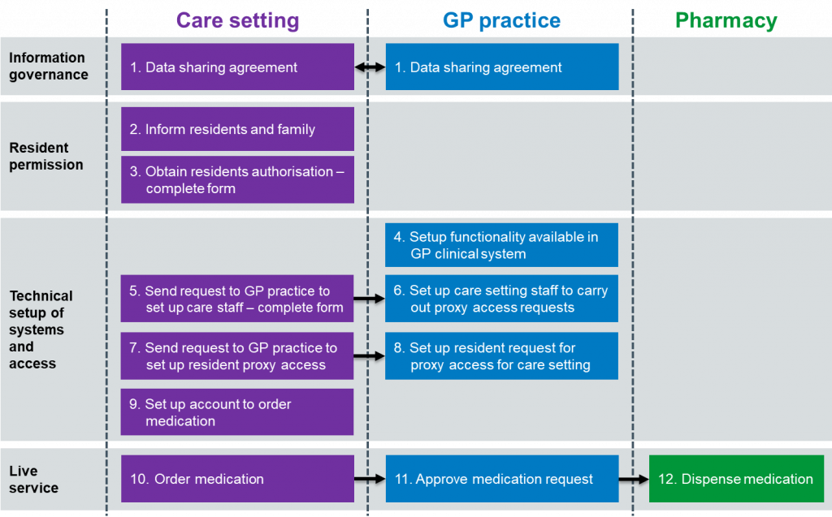
Proxy Ordering Step by Step

Slide 11
Proxy Ordering
This Photo by Unknown Author is licensed under CC BY-SA

