Slide 1
Place Based Placements
Scott Topping
Senior PDN & RePAIR Fellow

Slide 2
My Roles
SWLSt.G MH NHS Trust /
SWL STP
Senior Practice Development Nurse
2 days per week
Place Based Placements
Coproduction
Health Education England
RePAIR Fellow
3 days per week
Regional cover, London

Slide 3
Place Based Placements
Culture renovation – not system based
HEE funded, national programme
Underpinned by revised NMET tariff
Minimum 1 week commitment
Adult Nursing
Children's Nursing
Mental Health Nursing
Learning Disabilities Nursing
Occupational Therapy
Physiotherapy
Kingston & St. George’s University London

Slide 4
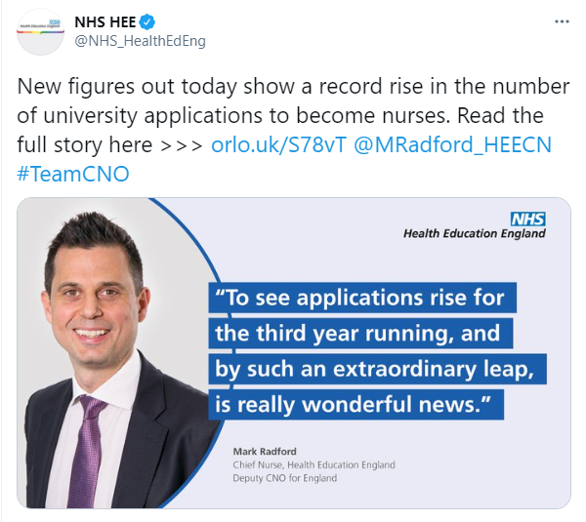
Good news!
60,130 Applications
32%

Slide 5
Nursing & Care Homes
Do you currently facilitate student placements?
If so, what is your experience?
If not, what are the barriers?
Contact details:
Monday & Tuesday – Scott.Topping@swlstg.nhs.uk
Wednesday – Friday – Scott.Topping@hee.nhs.uk
Notes:
Print off Springfield Map.

