Slide 1
Information Sharing Webinar COVID-19 11am -12 noon Tuesday 23rd February 2021
Relevant for Care Home staff in Croydon Richmond Merton Wandsworth Kingston and Sutton
Introduction and Vaccine Update Viccie Nelson SWL CCG Associate Director of Transformation
Supporting Recruitment for the Care Sector Polly Persechino Policy and Programme Manager – Economy, Skills and Employment South London Partnership
Place Based Placements Scott Topping Health Education England, working across London
IPC Updates Debbie Calver Infection Prevention and Control Nurse Specialist SWL CCG
Please use the chat function on Teams to ask questions.
Please mute your lines and turn off your video as the webinar will be recorded.
The webinar will start at 11am
If you have any questions or any suggestions on what you would like to see covered in these webinars please email: infectioncontrol@swlondon.nhs.uk

Slide 2
Joint advice from the NHS and law enforcement agencies on protecting yourself from COVID-19 cons
In the UK, coronavirus vaccines will only be available via the National Health Service.
You can be contacted by the NHS, your employer, a GP surgery or pharmacy local to you, or as a reply to the email you have sent to the SWL referral email address to receive your vaccine.
Remember, the vaccine is free of charge. At no point will you be asked to pay.
The NHS will never ask you for your bank account or card details.
The NHS will never ask you for your PIN or banking password.
The NHS will never arrive unannounced at your home to administer the vaccine.
The NHS will never ask you to prove your identity by sending copies of personal documents such as your passport, driving licence, bills or pay slips.

Slide 3
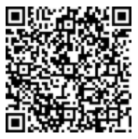
Staff Recruitment Survey
Support available from The Prince’s Trust
The Prince’s Trust has committed to supporting 10,000 young people aged 18-30 into careers within Health & Social Care over the next four years.
To take part in this programme all The Princes Trust needs is entry level roles for young people to interview for and someone to interview them on the recruitment day.
To access our survey please SCAN :
Student Placements
Are you interested in hosting a placement student (Nurses and AHPs in training) ?
Individual placements run for a minimum of 3 weeks, we can establish a regular rotation of placements, supervision is required (but training and support for your staff is provided).
Recruiting staff
The Work and Health Programme is an employment support programme, seeking to find long term sustainable employment opportunities for people in south London.
Please let us know about your recruitment needs - we may be able to help.
For further information please contact : paul.harper@swlondon.nhs.uk

Slide 5
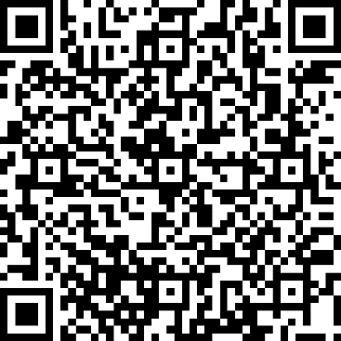
Covid-19 Electronic Booking Form
This form is for anyone that has concerns about attending a hospital hub for the vaccine and/or having difficulty with booking a vaccine through swift queue and/or would prefer to attend a local GP Surgery in South West London
Your details will be logged and contact will be made within 24hrs to provide the necessary support to access the vaccine.

Slide 6
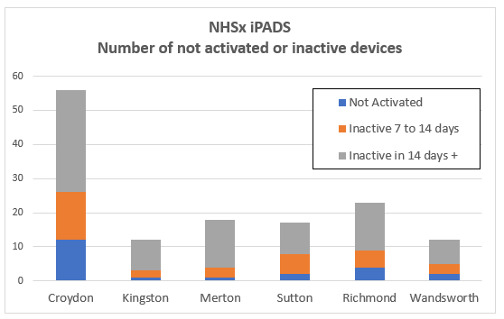
NHSx iPADs
Please get in touch if you need help to activate your iPAD
Technical support for your iPad is available from the iPad supplier, Jigsaw24, they can be contacted on 03332 409 234, or by email at carehomesupport@Jigsaw24.com
Additional set up guidance and video tutorials are available via the Digital Social Care website. This includes guidance for using NHSmail and MS Teams on the iPad.
Weekly set up and troubleshooting webinars run by Digital Social Care are available.
If you get stuck, please get in touch
Note : 311 devices were allocated across South West London. 7% have yet to be activated.
For help and support please contact : swlcarehomes.admin@swlondon.nhs.uk

Slide 7
Staff Recruitment
Support available from The Prince’s Trust
The Prince’s Trust has committed to supporting 10,000 young people aged 18-30 into careers within Health & Social Care over the next four years.
To take part in this programme all The Princes Trust needs is entry level roles for young people to interview for and someone to interview them on the recruitment day.
Student Placements
Are you interested in hosting a placement student (Nurses and AHPs in training) ?
Individual placements run for a minimum of 3 weeks, we can establish a regular rotation of placements, supervision is required (but training and support for your staff is provided).
Recruiting staff
The Work and Health Programme is an employment support programme, seeking to find long term sustainable employment opportunities for people in south London.
Please let us know about your recruitment needs - we may be able to help - look out for our Survey Monkey.
For further information please contact : paul.harper@swlondon.nhs.uk

Slide 8
Capacity Tracker Webinars for Home Care Providers
Every Friday at 2:00pm.
Back-to-Basics with Q&A
Update on changes and troubleshooting
Click here to join the meeting
Or call in (audio only)
+44 20 3794 0272,,851270186#
United Kingdom, London Phone Conference ID: 851 270 186#
For the meeting series contact : paul.harper@swlondon.nhs.uk

